Slide 1
Autonomous Predictive Maintenance Agent for Smart Factory
Subtitle: Conceptual Design using Generative AI & Edge/IIoT Integration
Course: ITAI 3377 Capstone Project
Student Name: Win Ko Aung
Date: August 4, 2025
Notes:
Hello everyone, my name is Win Aung, and this is my Capstone Project for ITAI 3377. Today, I’ll present the conceptual design of an AI-powered autonomous maintenance agent for smart factories. The system uses Generative AI and Edge/IIoT technologies to predict equipment failure and help reduce downtime.

Slide 2
Use Case Overview: Predictive Maintenance in Smart Factories
Sensor Data Utilization
Sensor data continuously monitors equipment health to detect early signs of potential failures.
Failure Prediction Analytics
Advanced analytics process sensor data to predict when maintenance is needed before failures happen.
Operational Benefits
Predictive maintenance reduces downtime and extends machinery lifespan, boosting productivity and saving costs.
Notes:
Let me start with an overview of the project. In smart factories, machine breakdowns cause costly delays. My project idea is to use AI at the edge to monitor equipment in real-time, detect issues early, and send alerts before a failure happens. This improves efficiency, safety, and cost-effectiveness.

Slide 3

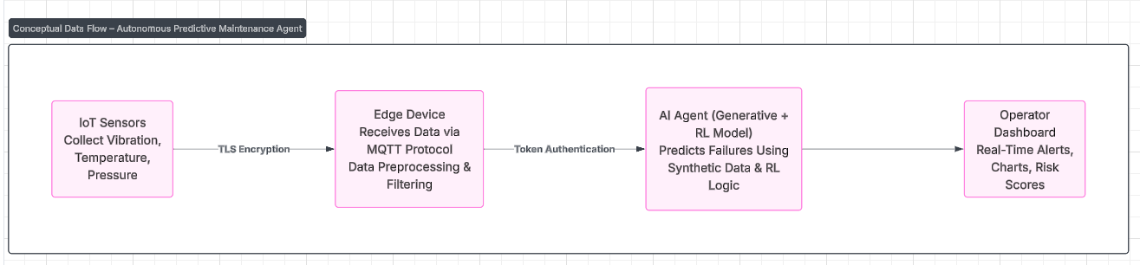
Conceptual System Architecture & Data Flow
IoT Sensor Integration
IoT sensors collect real-time data from the environment to enable timely system responses.
Edge Data Processing
Edge devices preprocess data to reduce latency and optimize cloud communication.
Predictive AI Agent
An AI agent at the edge analyzes incoming data using generative models and reinforcement learning to predict failures and alert operators.
Notes:
Here is the system architecture and how the data flows. First, IoT sensors collect data like vibration, temperature, and pressure. This data is securely sent to the edge device using MQTT with TLS encryption. The edge device filters and preprocesses the data before passing it to the AI agent. The AI agent uses Generative AI and Reinforcement Learning to predict failures. Finally, predictions are sent to a dashboard so operators can take action.

Slide 4
Generative AI & Autonomous Agent Design
Adaptive Decision-Making
Generative AI allows agents to adapt decisions dynamically based on evolving scenarios and data inputs.
Scenario Simulation
Generative AI enables simulation of multiple scenarios to predict outcomes and optimize agent response.
Real-Time Maintenance
Autonomous agents use AI and real-time data to detect maintenance needs and suggest optimal actions promptly.
Notes:
The AI agent is the brain of this system. It uses Generative AI to create synthetic training data and Reinforcement Learning to adapt its decision-making. This allows the system to learn from patterns and improve over time, even if real failure data is limited. Tools like TensorFlow Lite and Edge Impulse can be used if this were implemented.

Slide 5

Edge/IIoT Integration & Security Features
Edge Computing Benefits
Edge computing processes data close to machinery, reducing latency and improving real-time responsiveness in industrial settings.
IIoT Device Connectivity
IIoT devices interconnect various factory assets, enabling seamless communication and efficient operations across the industrial network.
Security Measures
Key security features including encryption, authentication, and intrusion detection safeguard sensitive industrial data and systems.
Notes:
Security is a big concern in smart factories. This design includes encryption, role-based access, and anomaly detection to protect data. Ethically, we must be careful of bias in training data and be transparent in how AI makes decisions. Also, monitoring workers with AI should respect their privacy.

Slide 6

Security & Ethical Considerations in Smart Factories
Data Privacy Protection
Protecting sensitive data in smart factories is essential to prevent unauthorized access and breaches.
Cyber Threat Defense
Implementing robust cybersecurity measures is crucial to defend against cyber attacks on factory systems.
Ethical AI Use
Responsible AI usage requires transparency in decision-making and minimizing job disruption.
Regulatory Compliance
Adhering to regulations ensures smart factories operate within legal and ethical boundaries.
Notes:
Security is a big concern in smart factories. This design includes encryption, role-based access, and anomaly detection to protect data. Ethically, we must be careful of bias in training data and be transparent in how AI makes decisions. Also, monitoring workers with AI should respect their privacy.

Slide 7
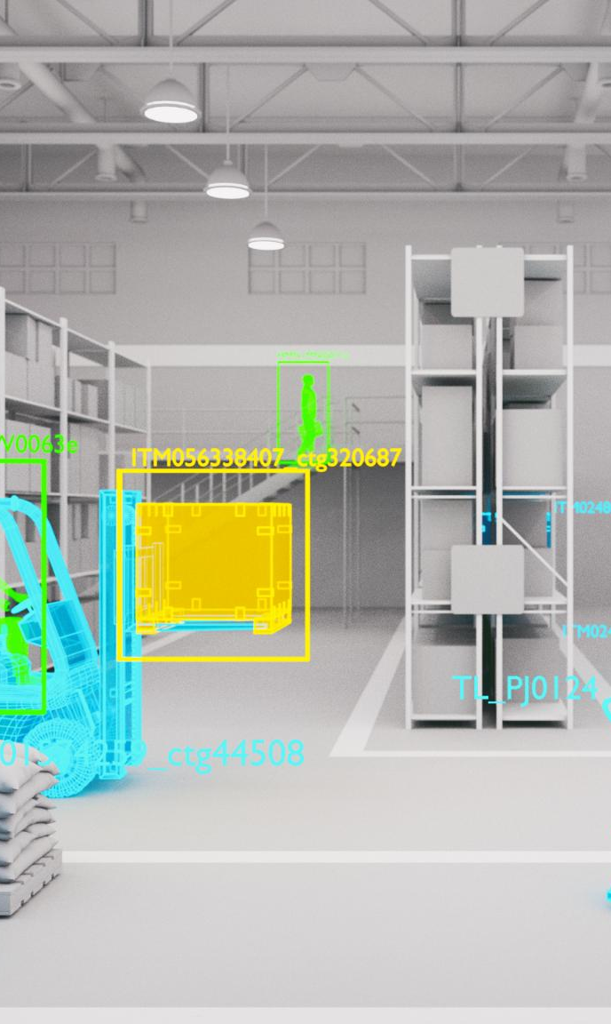
Testing & Deployment Plan (Theoretical Approach)
Simulation of Factory Scenarios
Testing includes simulating real factory conditions to evaluate system performance before deployment.
Validation of AI Predictions
AI models are validated to ensure accurate predictions and effective decision-making.
Stress-Testing Security Protocols
Security protocols undergo rigorous stress testing to identify vulnerabilities and enhance protection.
Phased Deployment Strategy
Deployment starts with pilot projects followed by full-scale implementation to ensure reliability.
Notes:
If I were to implement this, I would start by testing the AI agent with simulated failure data. I would monitor how fast and accurately it predicts problems. I’d also test how the system responds during cyberattacks or communication failures. The goal is to make sure it’s reliable, secure, and useful in real-time.

Slide 8
Key Takeaways & Future Applications
Autonomous Predictive Maintenance
Predictive maintenance agents enable smart factories to proactively manage assets and reduce downtime.
Enhanced AI Capabilities
Future advancements will improve AI's ability to analyze data and optimize factory operations autonomously.
IIoT Integration
Broader integration of Industrial Internet of Things devices will connect equipment for better monitoring and control.
Fully Autonomous Operations
The goal is to achieve fully autonomous industrial operations for greater efficiency and productivity.
Notes:
On this slide, I want to highlight the main takeaways from the project and explore what’s possible in the future.
First, Autonomous Predictive Maintenance: This system helps factories take action before machines break down, which saves time and money. It’s all about being proactive, not reactive.
Second, Enhanced AI Capabilities: As AI improves, it will get better at understanding machine behavior, predicting issues, and making decisions without needing human help.
Third, IIoT Integration: The more we connect machines through the Industrial Internet of Things, the more data we can collect. This improves monitoring and control across the whole factory.
And finally, Fully Autonomous Operations: The long-term vision is a factory that can run itself—machines that fix themselves, systems that respond in real time, and operations that are always optimized.

Slide 9
Conclusion
Generative AI Integration
Generative AI enhances smart factory maintenance by enabling predictive failure detection, autonomous decision-making, and problem-solving at the edge.
Edge and IIoT Technologies
Edge computing and IIoT enable real-time data processing and connectivity critical for efficient industrial operations.
Benefits for Industrial Environments
Integration improves efficiency, security, and adaptability within industrial settings through autonomous agents.
Notes:
To conclude, this project shows how combining Generative AI, Edge computing, and IIoT can improve industrial systems. AI helps predict problems before they happen. Edge and IIoT enable fast data processing. Together, they can make factories more efficient, secure, and smart.

Slide 10

Thank You
Notes:
Thank you for listening. If you have any questions, I’d be happy to answer them.

